Slide 1
Update on new guest experiences
1st November 2024
Beatrice Tsang
Group Guest Experience Designer

Slide 2
Table of Contents
Phased Out Come Alive Experiences
Sunlife Come Alive Experiences
New Come Alive Collection
F&B Experience

Slide 3
Phased Out of Existing Come Alive Experiences

Slide 4
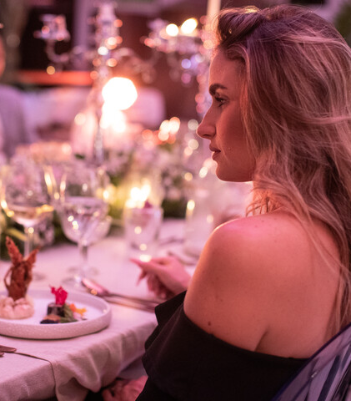
Phased Out Experiences
Putting on the Ritz – Sugar Beach
Time for tea – Sugar Beach
Energy Gym – Sugar Beach
These have been phased out due to lack of engagement.

Slide 5
New Sunlife Come Alive signature experiences

Slide 6
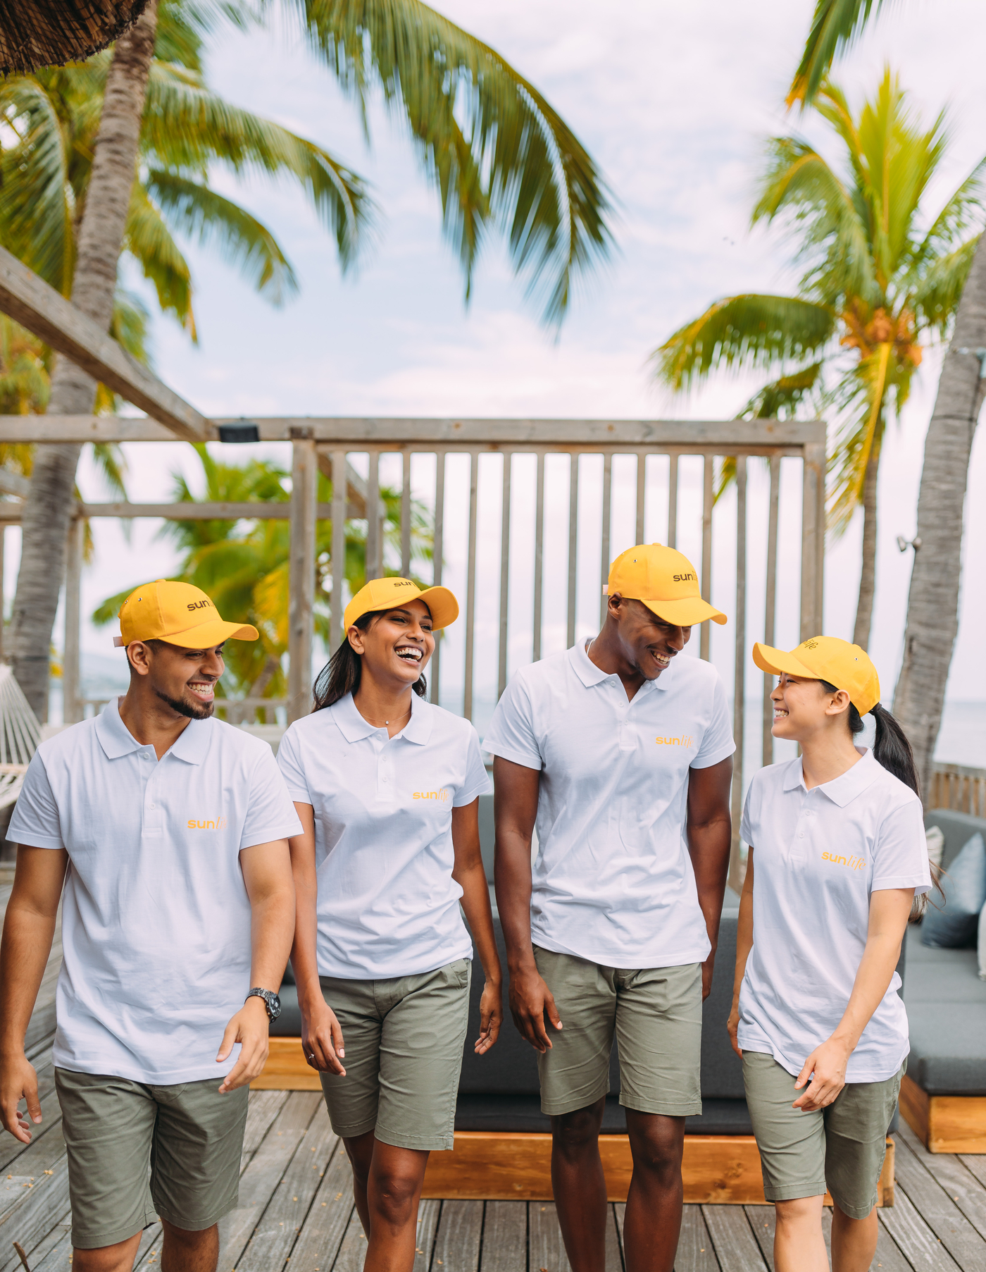
What’s the Beach Squad
The Beach Squad is a dedicated team tasked with delivering standardised beach services to ensure an exceptional guest experience. Young and dynamic, they stand apart from the rest of the team in their colourful uniforms

Slide 7
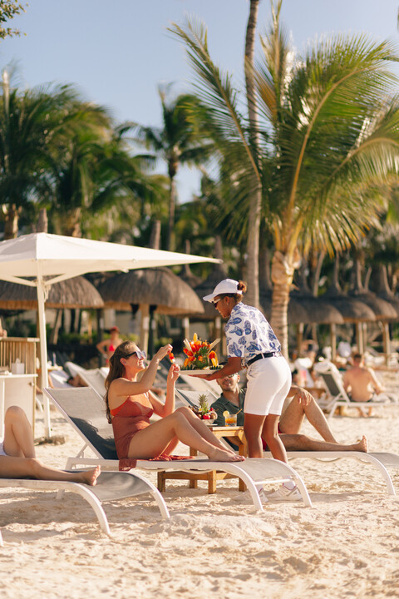
Ambre
Enhancements:- Implemented
Beach Refreshment such as: iced sugar cane and ice lollies.
Cold towels, glass cleaning, and mobile charging services.
Complimentary beach spa offerings.
Large variety of Beach Games such as: cornhole, giant Jenga, beach volleyball.

Slide 8
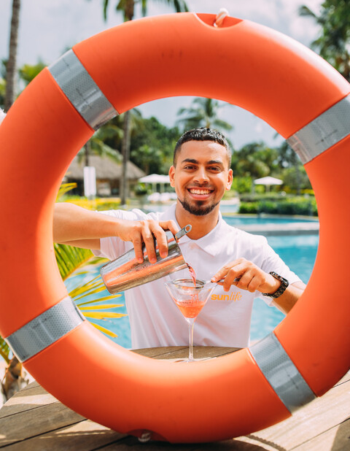
Beach Squad – La Pirogue
Enhancements: Implemented
Towel delivery clearing.
Beach gazebo set up & Lunch
Water dispenser & cup refill.
Service around pool area.

Slide 9
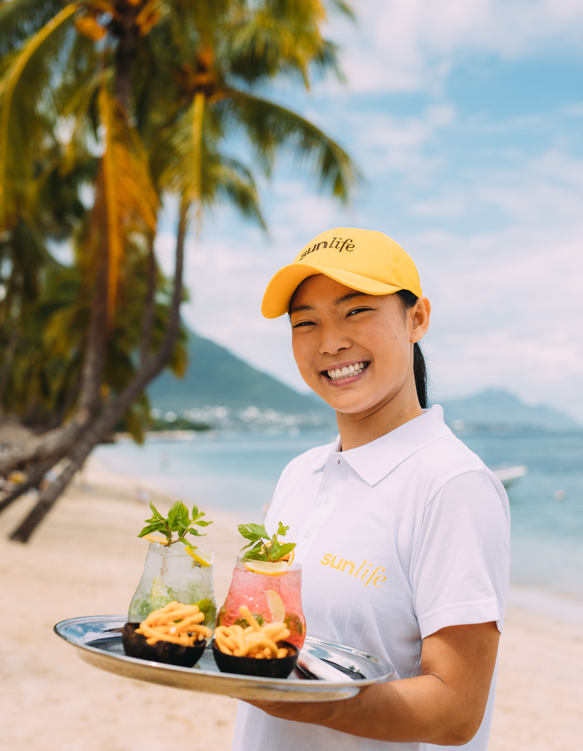
Long Beach
Enhancements:- Implemented
Bento Boxes
Pool and Beach Amenities.
Deployment of press for service buzzer across the pool and beach.
Cleaning of sun-glasses and towel service.
Water upon arrival.
Upgraded beach menu accessible via QR code.

Slide 10
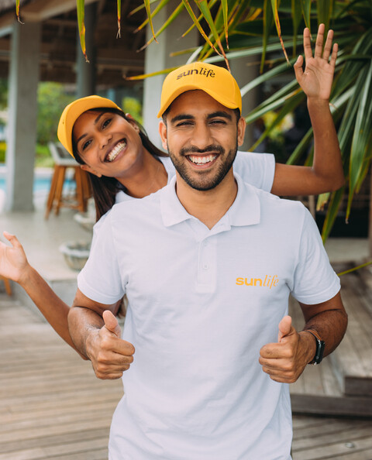
Sugar Beach
Enhancements
Implemented mid-November
Bento Boxes.
Pool and Beach Amenities.
Deployment of press for service buzzer spread from Citronella to Adults pool.
Deployment of two beach kiosks across the beach.
Introduction of Bento Boxes for a beach dining experience.

Slide 11
Island Trails – LB, LP & SB
The Treasure Hunt is an online hunt through a mobile app where guests earn points by completing fun challenges across the resort. Tasks include photo challenges, quizzes and crosswords.

Slide 12
New Come Alive Experiences
Sugar Beach

Slide 13
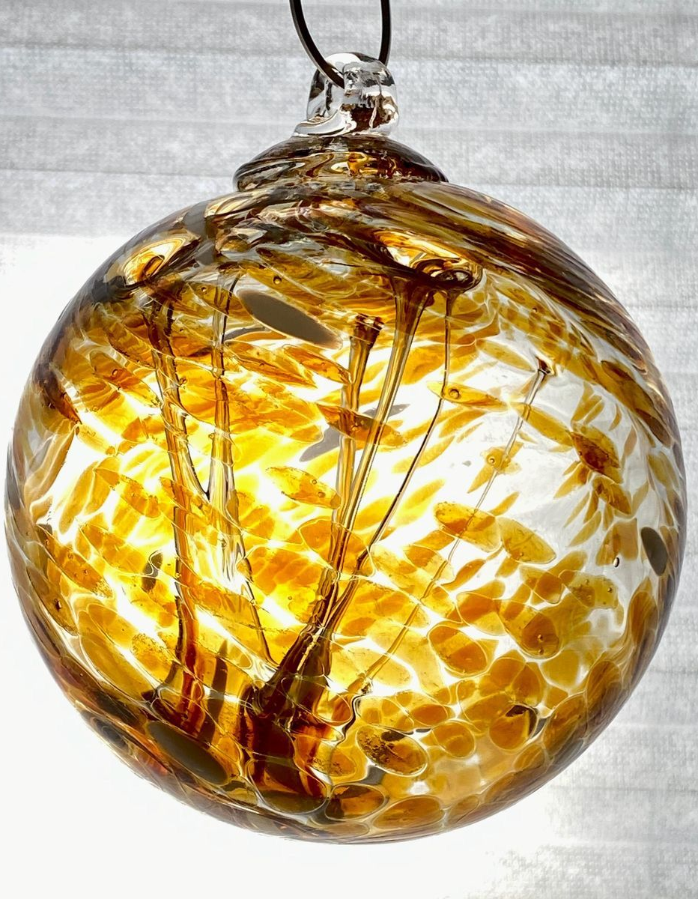
Glass Studio
The Glass Studio will offer unique experiences for guests of all ages to create their own masterpieces to take home. Each piece made at the Glass Studio will be crafted using recycled glass bottles sourced from our resorts.
Frequency: Twice per week
Location: Governor's Lounge
Type of : Paid activity

Slide 14
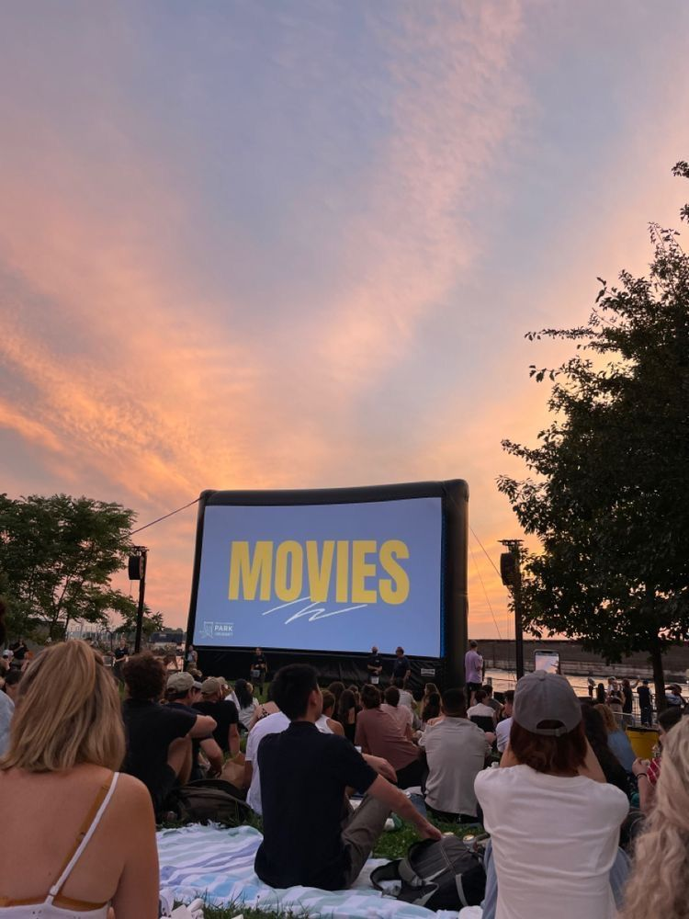
Cinema under the Stars
Our Manor Lawn becomes a 1,800 sq. outdoor cinema, where guests enjoy films under the stars. Savour a chef-crafted menu with local dishes and favourites like gourmet burgers, plus complimentary popcorn, candy floss, and ice cream.
Frequency: Twice per week
Location: Governor's Lounge
Price: Paid activity

Slide 15
New Come Alive Experiences
La Pirogue

Slide 16
Dodo Wish
The Dodo Wish sculpture invites guests to clip their sustainability pledges, promoting environmental stewardship and inspiring action during their stay and beyond.
Frequency: Art installation in the Garden
Price: Complimentary
Location: La Pirogue Garden

Slide 17
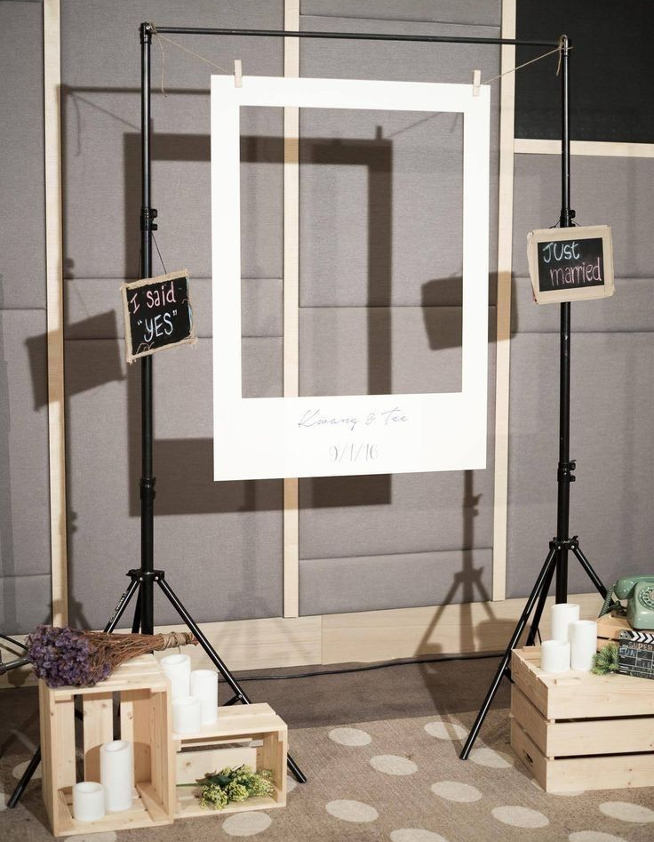
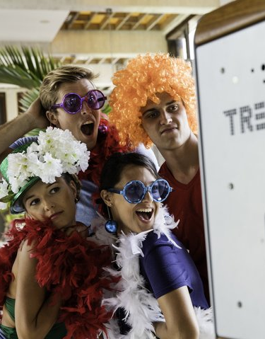
Photo-Booth
Introducing a modern photo booth on the beach, set against the stunning backdrop of Le Morne, where guests can print or email branded photos
Frequency: Available daily
Price: Paid activity
Location: Movable

Slide 18
Sunset Ritual
The Sunset Ritual at La Pirogue invites guests to gather on the beachfront before sunset. With comfortable seating, soft music, local delicacies, and crafted drinks, it's the perfect way to relax as the sun sets over the Ocean.
Frequency: Weekly
Price: F&B at a supplement
Location: Le Morne Beach Bar

Slide 19
New Come Alive Experiences
Long Beach

Slide 20
Vibe & Ride
Vibe and Ride offers two exciting routes to explore the East. The 18 km route passes through Flacq Market, while the 22 km route explores Bras D'eau National Park and a Hindu temple. Electric hybrid bikes add a boost to your journey.
Frequency: Saturday & Wednesday
Booking: 24 hrs in advance
Price: 1500 per person

Slide 21
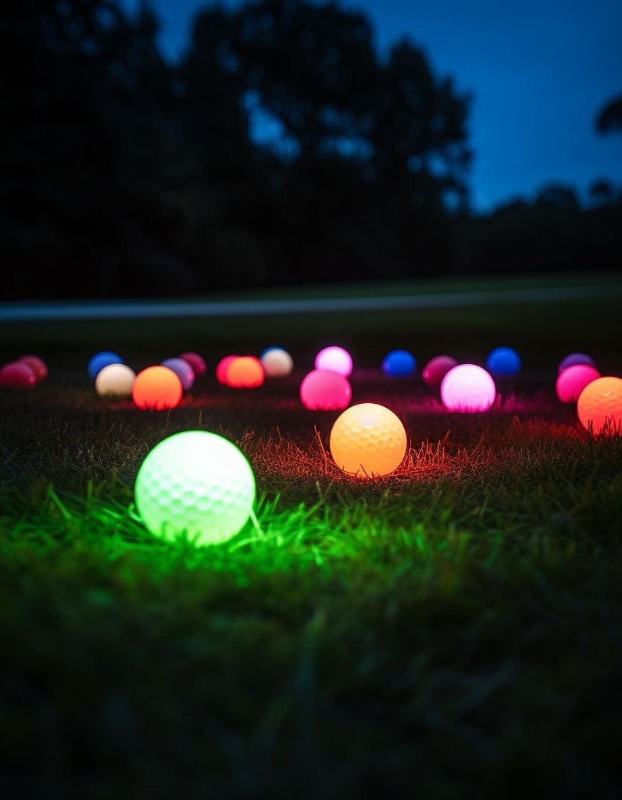
Brilliant Bocce
Set underneath the palm trees of the ocean lawns - fun for all ages and easy to learn. The perfect activity for some after dinner sporty actions
Frequency: Wednesday / Saturday
Price: Complimentary
Location: Shores Bar

Slide 22
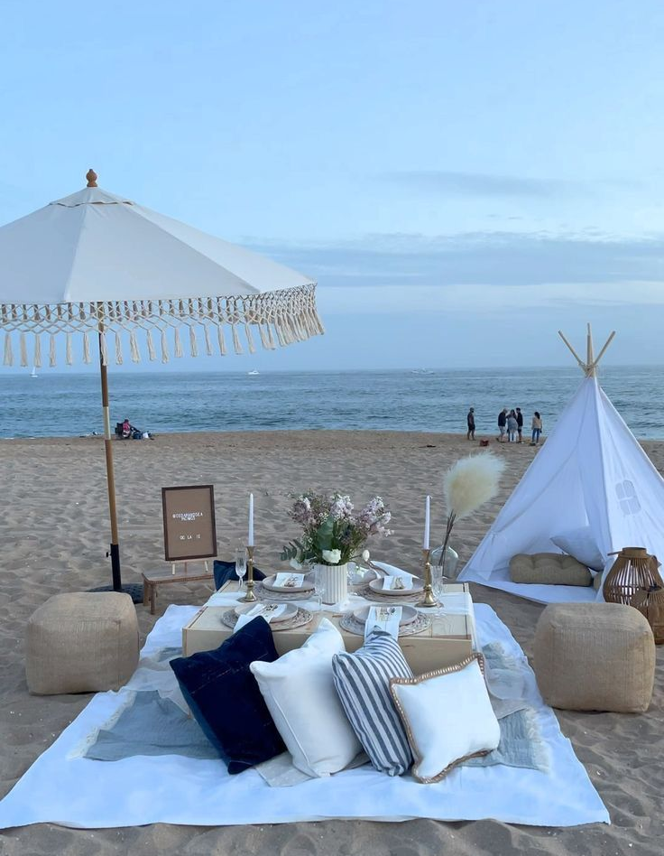
La Cabanna
Enjoy an elevated Mauritian picnic with terracotta crockery and hand-forged cutlery in four secluded spots at Long Beach. Savour authentic dishes with the soothing backdrop of waves and local music.
Frequency: Requires 24-hour advance booking
Price: Depending on the theme
Location: Two secluded location across long Beach

Slide 23
F&B Experience

Slide 24
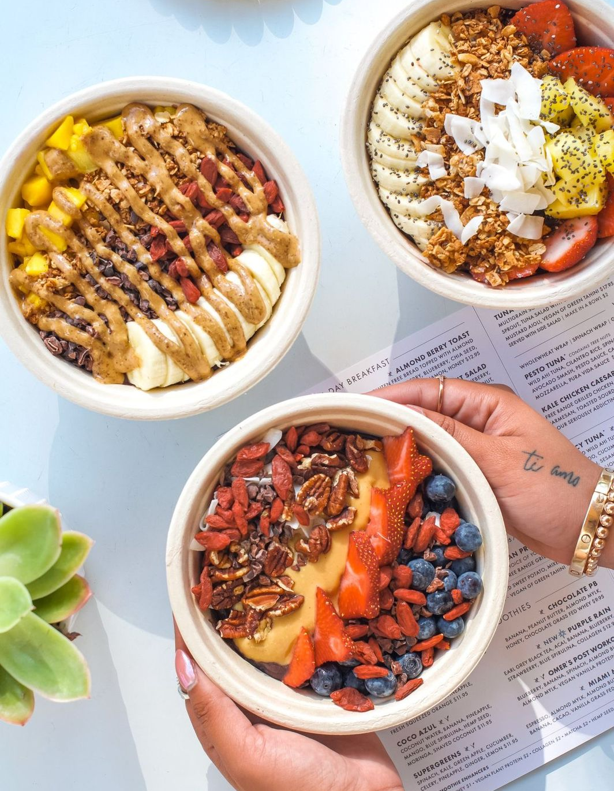
Plant- Based Lifestyle
Our vision for plant-based options across our restaurants and bars is to offer environmentally conscious, flavourful and locally sourced dishes. This initiative aligns seamlessly with our new spa concept, which promotes a healthy mind-body connection.
Started at Long Beach and will be fully deployed across the collection by 2025.

Slide 25
Thank you
TX +230 402 0000 F +230 402 0199​
E info@sunlife.mu W yoursunlife.com
Ebene Skies, Rue de l’Institut, Ebène 72201, Mauritius​

